Slide 1

SkillCourt v.10
Team Members: Carlos Alva, Sandra Hurtado, Sergio Rosales Product Owner: Guðmundur Traustason
Instructor: Masoud Sadjadi School of Computing and Information Sciences Florida International University
Final Presentation
Spring 2018
Notes:
7 seconds.( I will select 2 best slides (i will give them extra points and students will present for CIS committee)
Greet your audience, thank them for attending your presentation, introduce yourself, introduce your project, introduce your team members, and quickly indicate what each of you did in a high-level manner, and put more emphasis on your part/contribution.

Slide 2

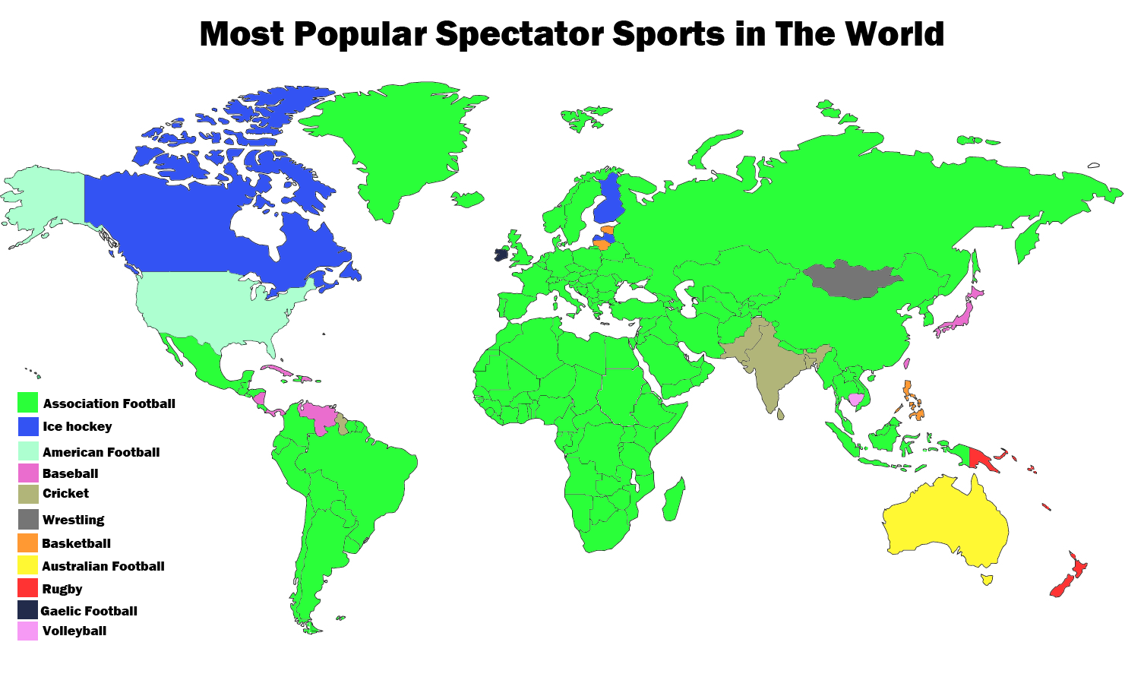
Why is Soccer Important?
The most popular sport in the world
Billions of passionate fans
Most practiced sport on the entire planet
Notes:
10 seconds.
Introduce the problem that the whole project (in all versions) tackles with GIF or screenshot.

Slide 3
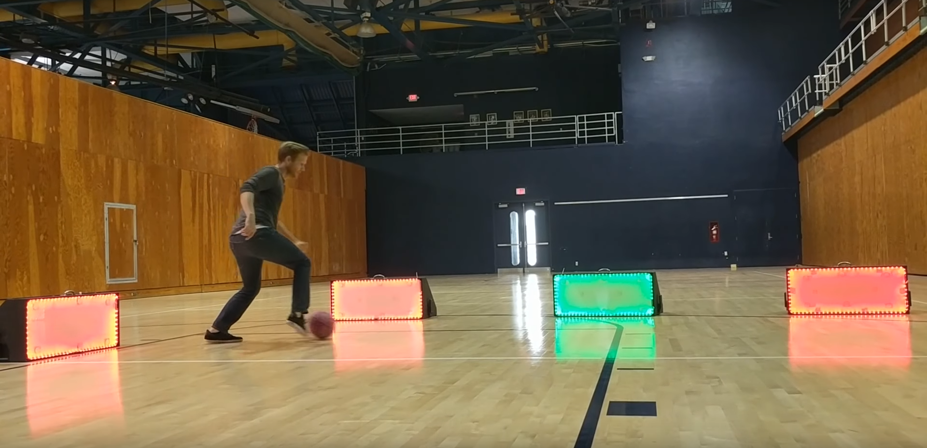
Why SkillCourt?
Soccer is practiced at all stages of life: Kids, Teens, Adults
Professional or Amateur level
What if everyone could train like a professional?
Notes:
10 seconds.
Introduce the problem that the whole project (in all versions) tackles with GIF or screenshot.

Slide 4
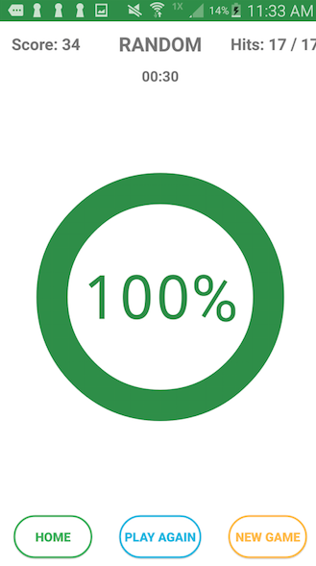
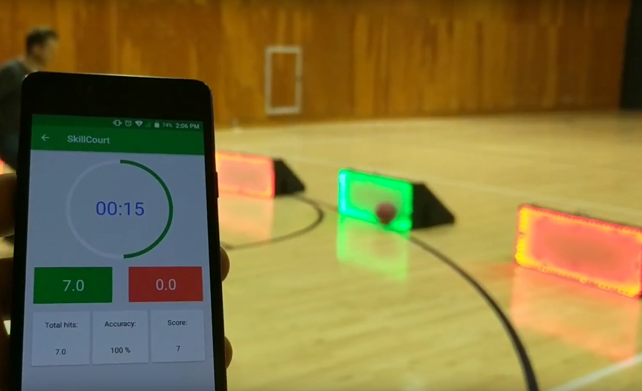
SkillCourt older Versions
Limited features
Random Mode
Pad Connection issues
Pad disconnects when Phone screen lock
App is minimized
Poor architecture design that prevents addition new feature and game modes
Notes:
10 seconds.
Introduce the problem that the whole project (in all versions) tackles with GIF or screenshot.

Slide 5
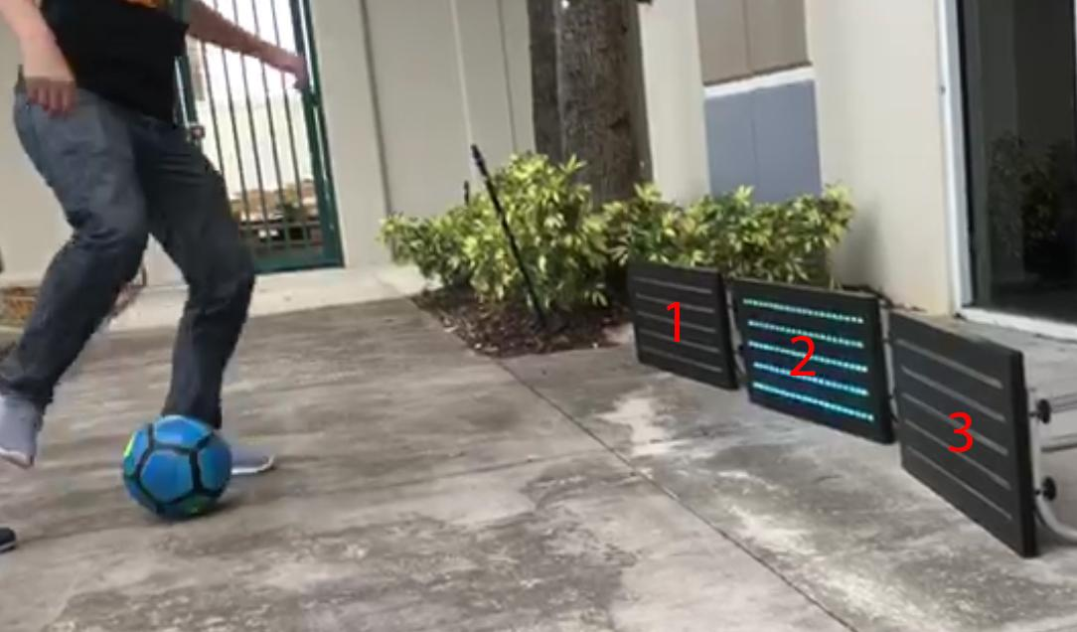
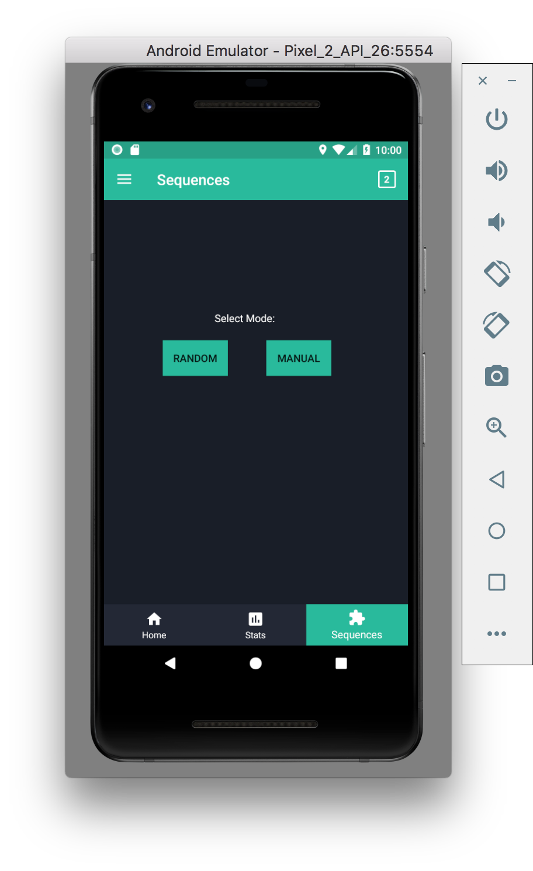
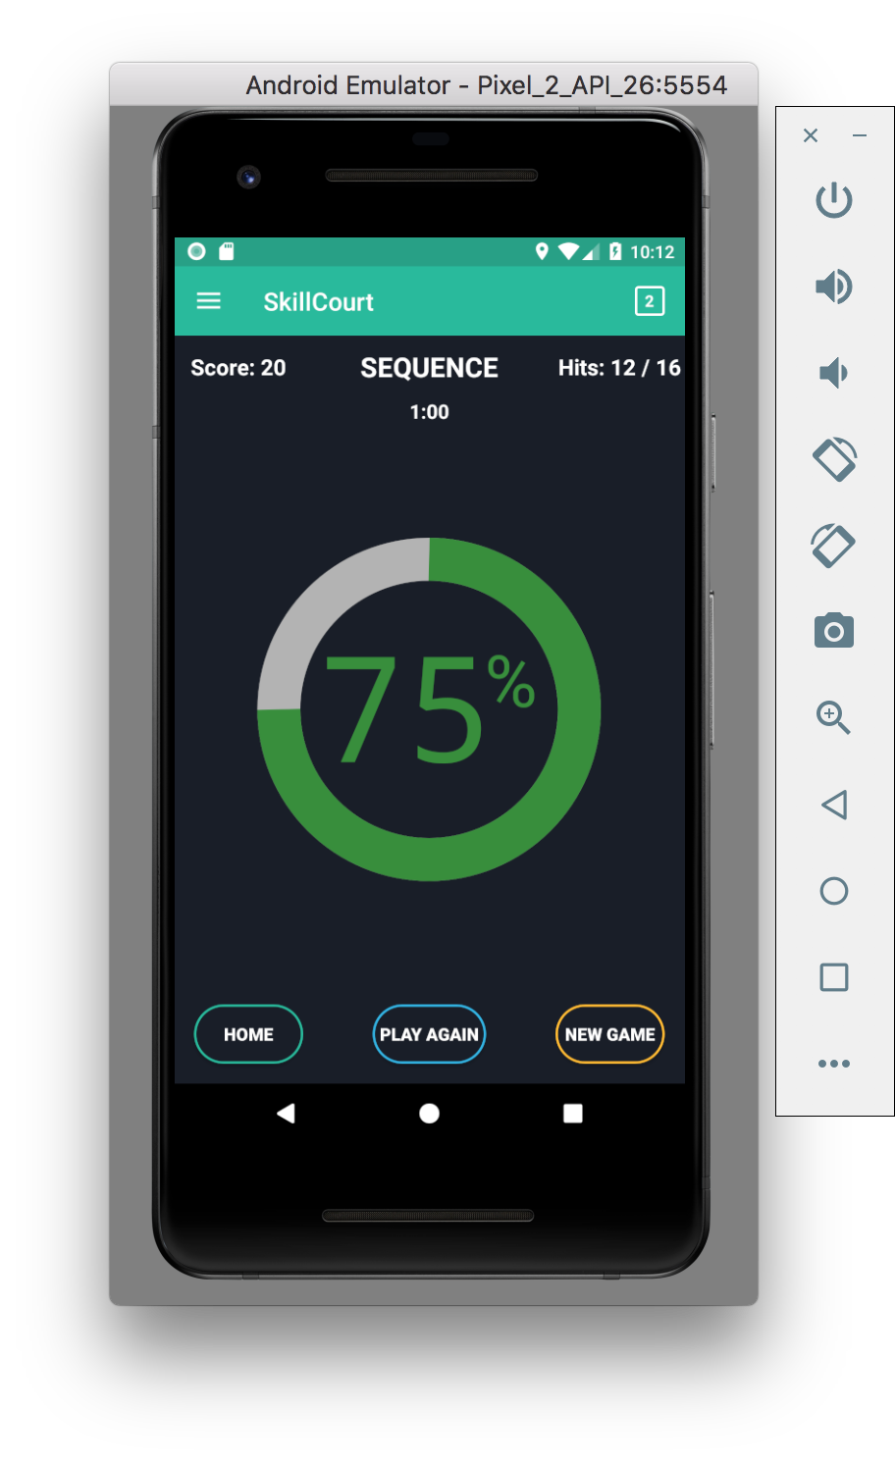
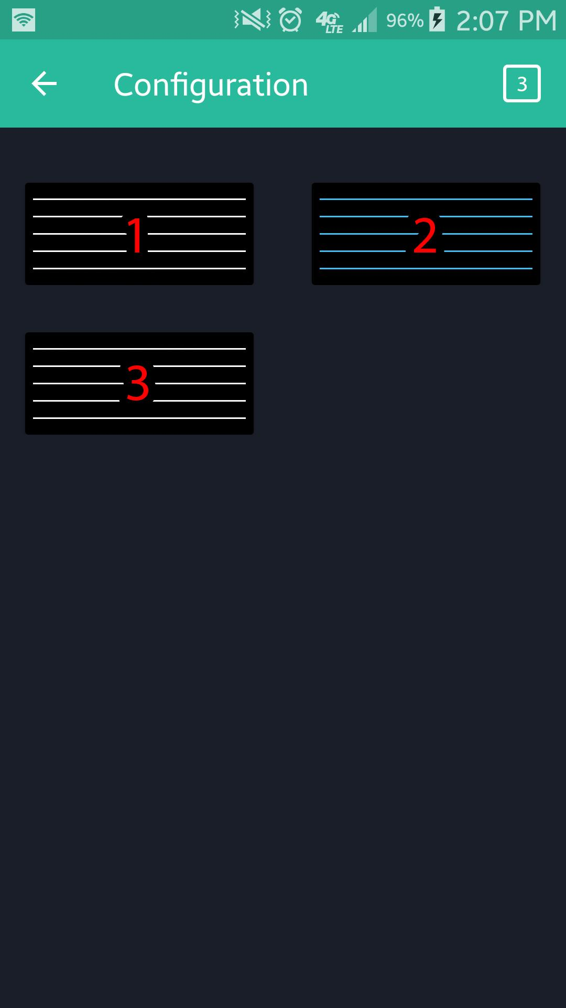
SkillCourt v.10
Refactoring entire architecture using Object Oriented design practices
App connectivity as a background service
Include new feature
Identify Pad order
Play Sequence Game mode
Notes:
20 seconds.
Introduce the problem that the your project (in new version) tackles with GIF or screenshot.

Slide 6
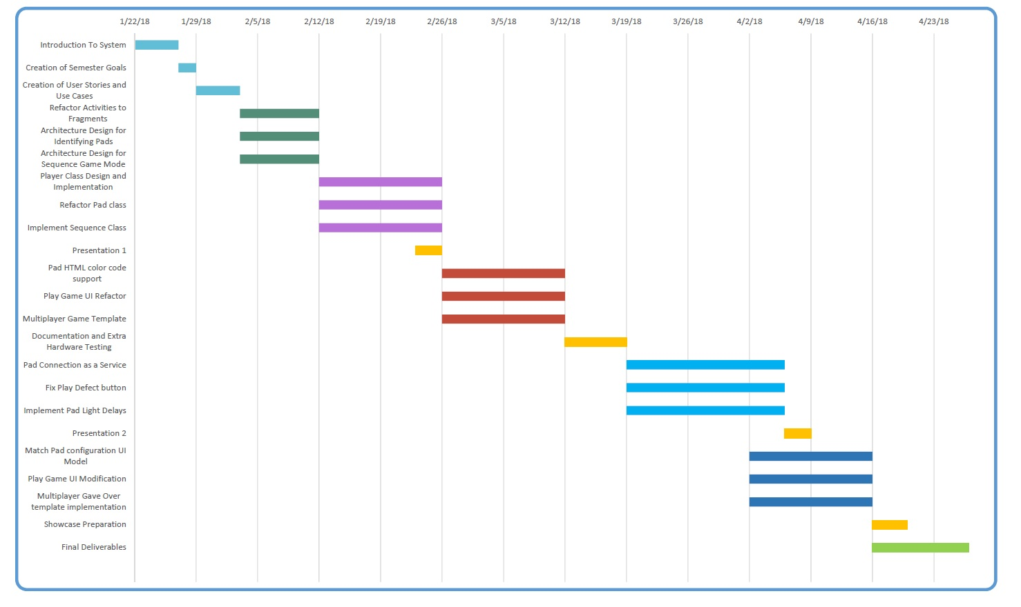
Project Management

Slide 7
User Stories Implemented
SC1137-Change UI from activities to fragments
SC1138-Design architecture to identify Pads
SC 1139-Design Architecture for Sequence
SC1145-Implement Player Class
SC1146-Implement and Refactor Pad Class
SC1147-Implement and Refactor Sequence Class
SC1156-Implement sending Hex Html color codes
SC1157-Refactor UI Design for user to play game
SC1158-Implement Multiplayer Game Template
SC1159-Refactor Pad Connection as a Service
SC1160-Fix floating “Play” button bug
SC1161-Customize Pad light up time
SC1168-Modify Pad Configuration UI to match Models
SC1169-Modify UI for Play Game
SC1170-Implement Multiplayer Game Over Template

Slide 8
Most Important User Stories
Change UI from activities to fragments
Refactor Pad Connection as a Service
Design Architecture for Sequence
Implement Player Class
Design architecture to identify Pads
Customize Pad light up time
Notes:
5 seconds.
List the user stories that you worked on them.(put in order of importance). Stay focused on the parts that you have been working.

Slide 9
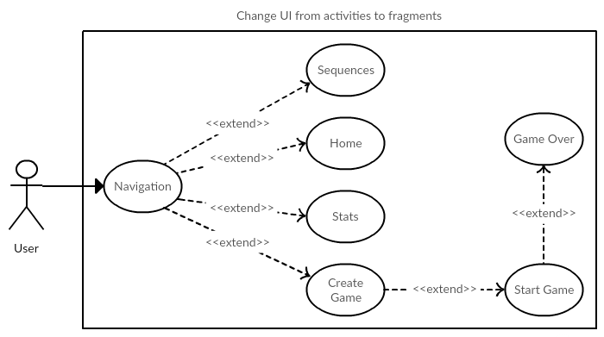
1. Change UI from activities to fragments
Actor: User
Preconditions: Application launches and starts MainActivity (Navigation Page) which contains an empty FrameLayout.
Description: User taps on any button/tab while in Navigation Page, then application will switch to that button/tab’s respective content. However, only the contents of the Navigation Page should be replaced, instead of starting a new application window (Activity).

Slide 10
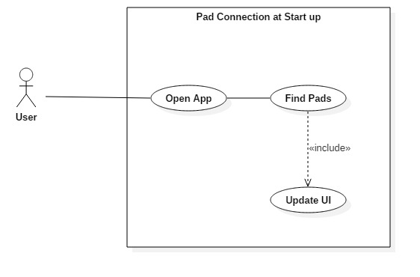
2. Refactor Pad Connection as a Service
Actor: User
Preconditions: Physical Pads are turned on User has a hotspot in his phone with the name: skillcourt and password: skillcourt
Description:
User opens the app
Pads should flash when connected to app
Symbol on the top right should display the number of pads currently connected

Slide 11
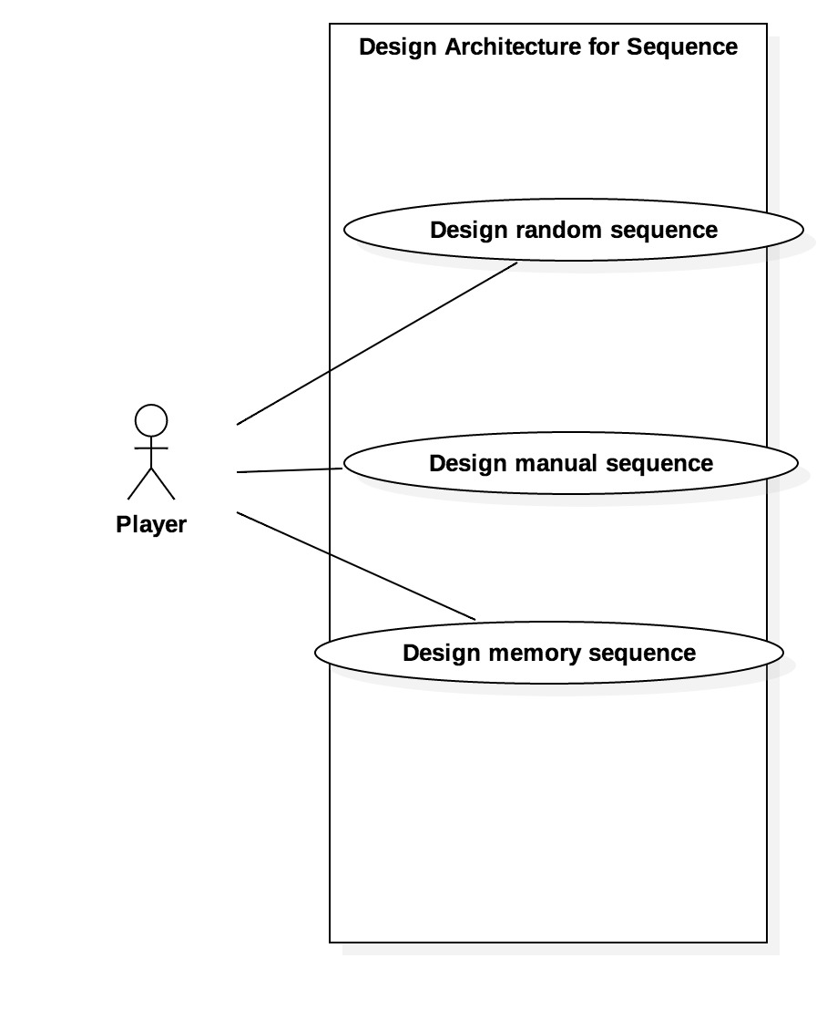
3. Design Architecture for Sequence
Actor: User
Preconditions: Must have pads identified and application open
Description:
Select Sequence button
Different options of sequences will display
Select the sequence of your preference
Show the newly created sequence to the player

Slide 12
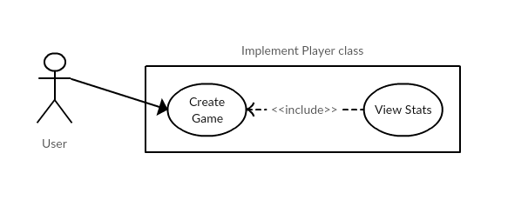
4. Implement Player Class
Actor: User
Preconditions: Must have pads identified and user must be in Create Game page.
Description: User selects the number of players and assigns each player a set of Pads. User then starts game. After game ends, the application will show the stats of each Player in separate views via dropdown menu.

Slide 13
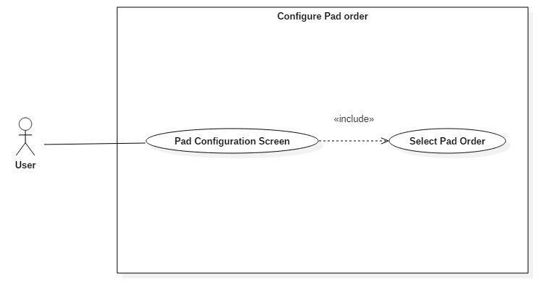
5. Design architecture to identify Pads
Actor: User
Preconditions: User just opened the app
Description:
User clicks on pad and sees it light up
Long Click Hold on the screen to enter Edit mode
Drag Pads to the order desired
Long Click Hold to exit Edit mode

Slide 14
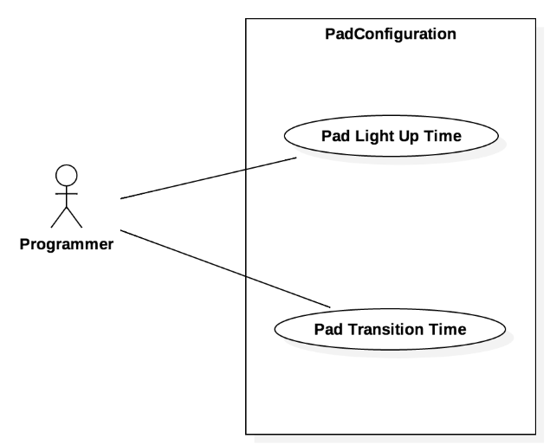
6. Customize Pad light up time
Actor: User
Preconditions: Must have pads identified and application open, and have number of player predetermined.
Description:
Select Play button
Choose Sequence mode
Select manual mode
Navigate to pad configuration
Choose the amount of time to light up and transition time.

Slide 15
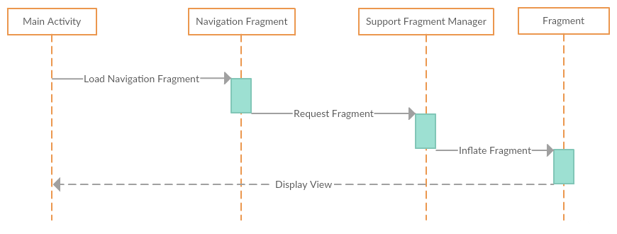
1. Change UI from activities to fragments

Slide 16
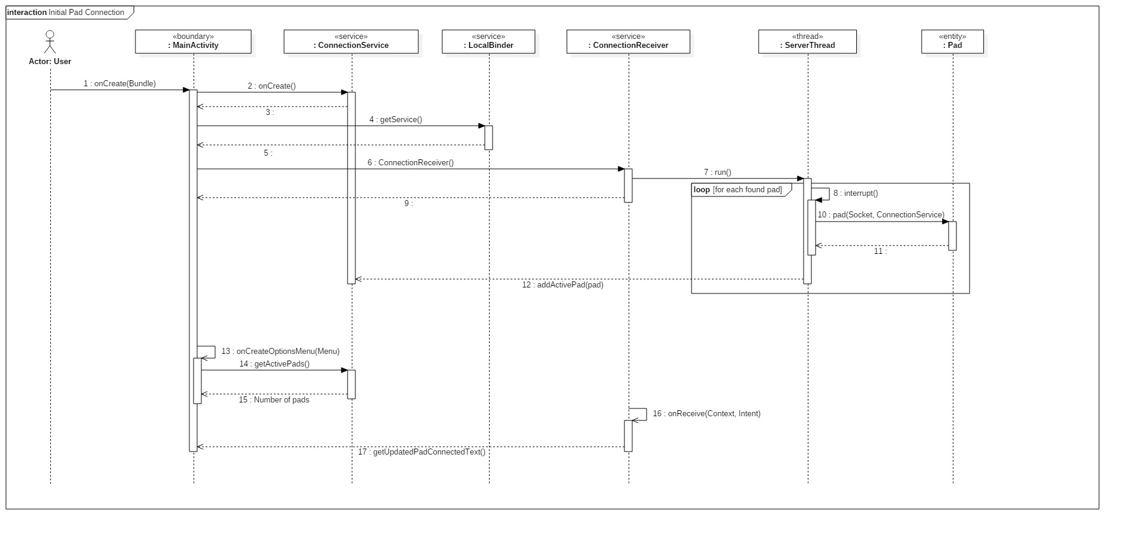
2. Refactor Pad Connection as a Service

Slide 17
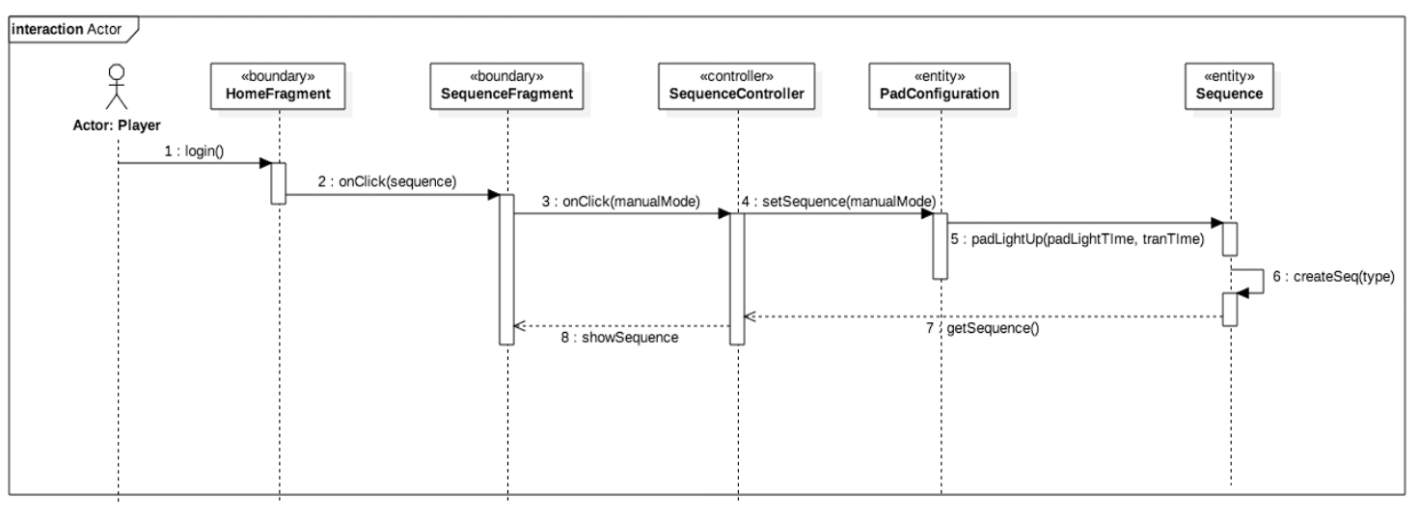
3. Design Architecture for Sequence

Slide 18
4. Implement Player Class

Slide 19
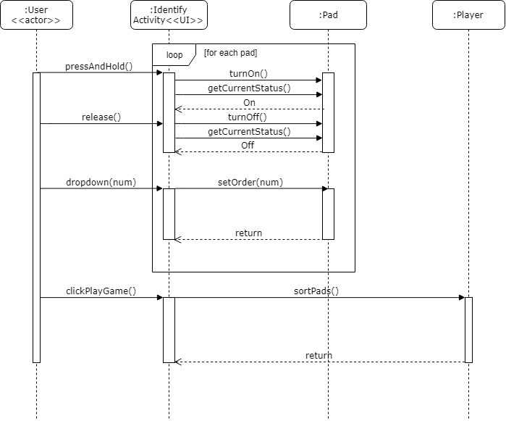
5. Design architecture to identify Pads

Slide 20
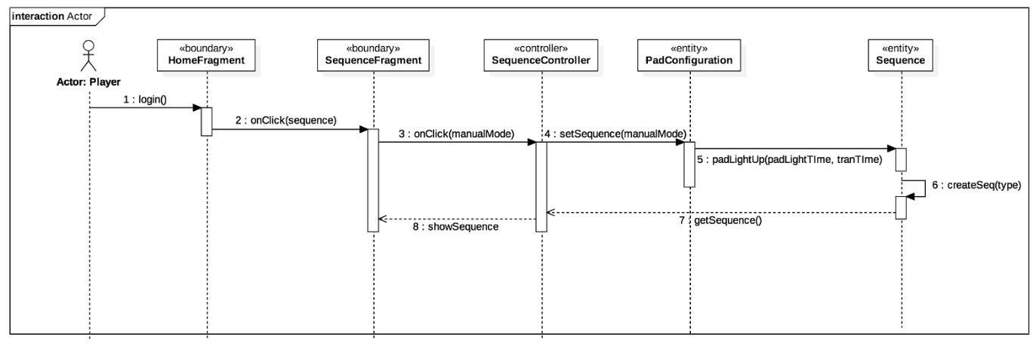
6. Customize Pad light up time

Slide 21
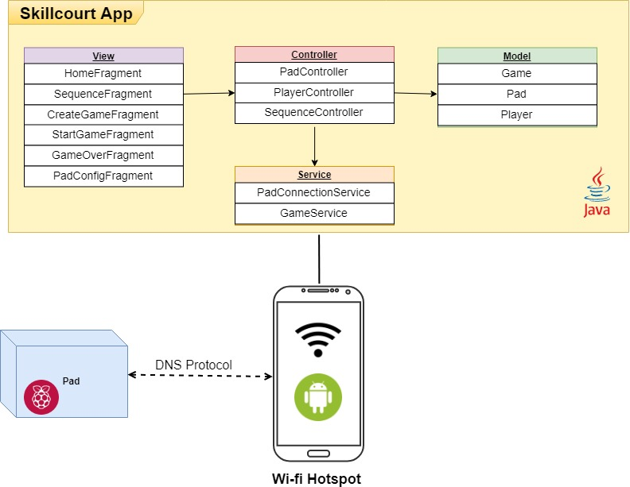
System Design: Architecture
MVC Model
Singleton: Main Activity, Game and Pad connection service
Iterators: Pad and Player classes
Event-based asynchronous: Hardware send Async messages to Connection service
Thread Pool: Connection service creates different Socket threads to handle multiple communication concurrently
API: Pad Class provides an interface to communicate with Hardware Pads
Notes:
20 seconds
System design: Highlight the parts that you contributed to them.
1. System decomposition; identify the architecture patterns used
2. System deployment – h/w and s/w requirements

Slide 22
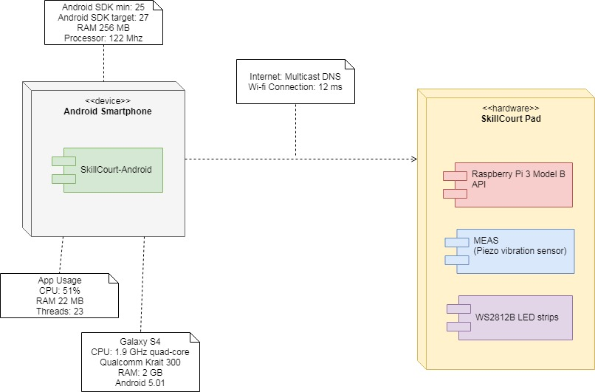
System Deployment:
Raspberry Pi 3
Wi-fi Board
MEAS Vibration Sensor
WS2812B LED Strips
Android Mobile system
DNS Protocol to find Pads connected on the network
Notes:
20 seconds
System design: Highlight the parts that you contributed to them.
1. System decomposition; identify the architecture patterns used
2. System deployment – h/w and s/w requirements

Slide 23
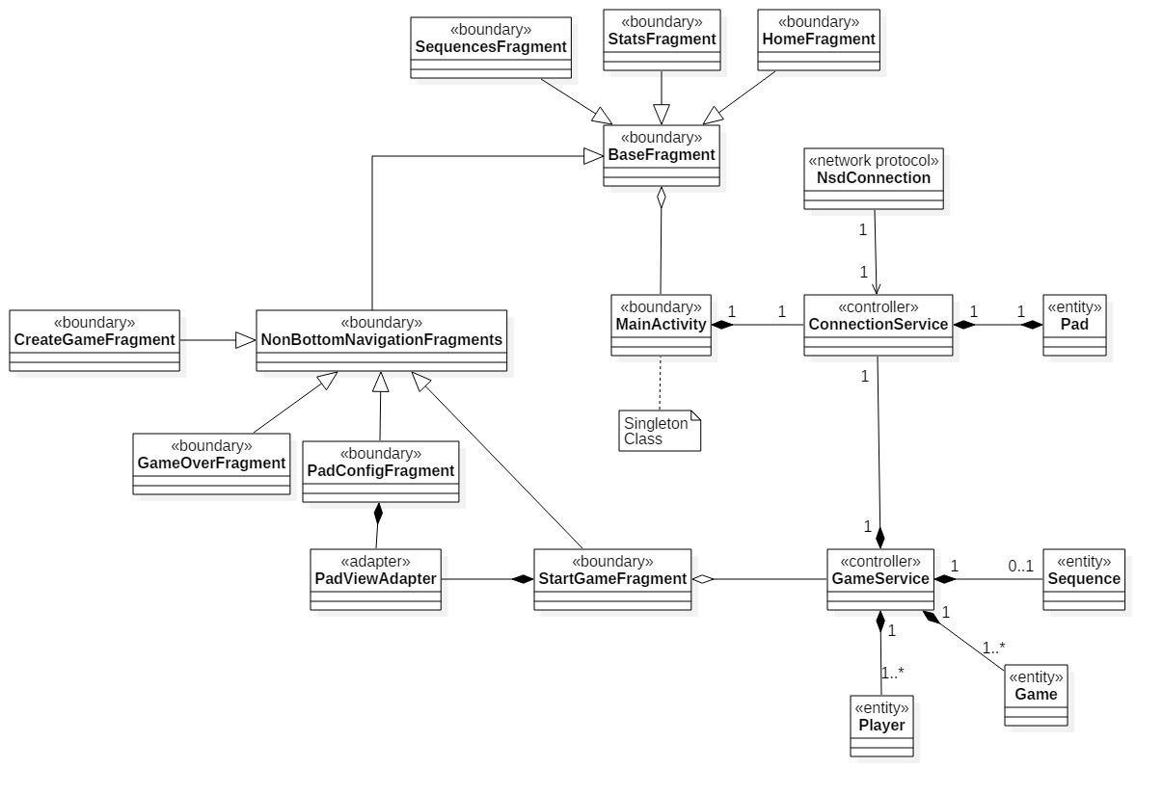
Minimal Class Diagram
Notes:
10 seconds.Minimal class diagram. Highlight the classes that you created/modified
Identify the design patterns used (one or more slides).

Slide 24
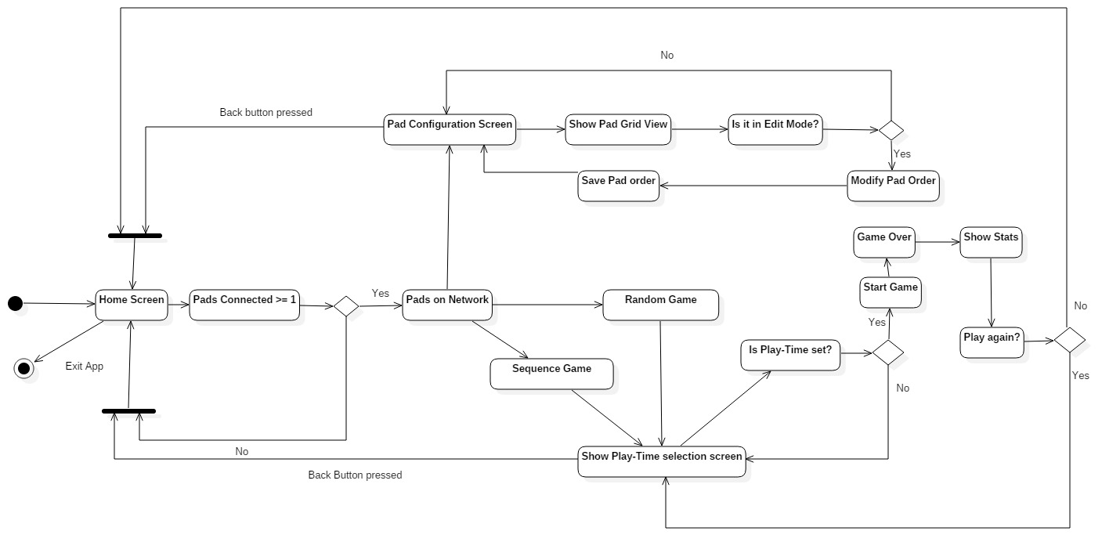
SkillCourt State Machine

Slide 25
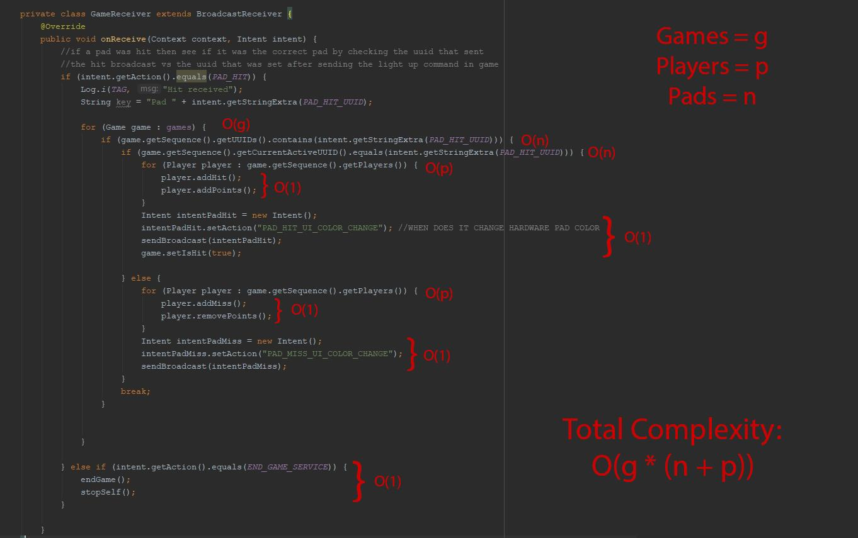
Main Algorithm

Slide 26
Test Suites and Test Cases
Sunny Test case ID: SC1006_ShouldUseTurnOnEnumWhenSendingMessage
Rainy Test case ID: SC1007_ShouldNotSendEnumIfSocketIsNotConnected
Sunny Test case ID: SC1008_TestSequenceConnection
Rainy Test case ID: SC1009_TestNoSequenceConnection
Sunny Test case ID: SC1010_fragmentsSunny
Rainy Test case ID: SC1011_fragmentsRainy
Notes:
10 seconds
A description of verification process and Test Suites and Test Cases for one of the use cases.
1 One sunny day and one rainy day for the implemented use cases (one or more slides).
2 Automated test scripts for the implemented use cases (if any) (one or more slides).

Slide 27
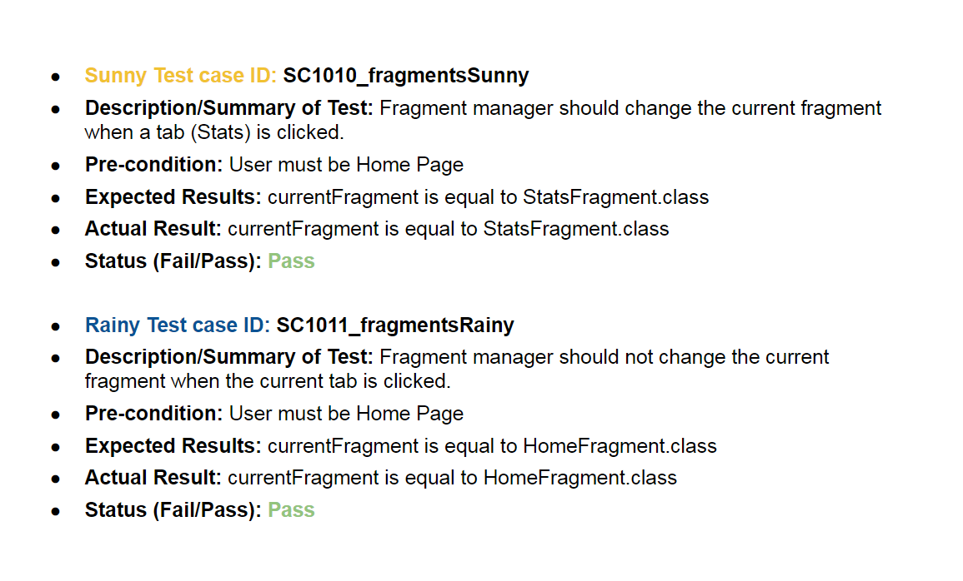
1. Change UI from activities to fragments Test Cases
Notes:
10 seconds
A description of verification process and Test Suites and Test Cases for one of the use cases.
1 One sunny day and one rainy day for the implemented use cases (one or more slides).
2 Automated test scripts for the implemented use cases (if any) (one or more slides).

Slide 28
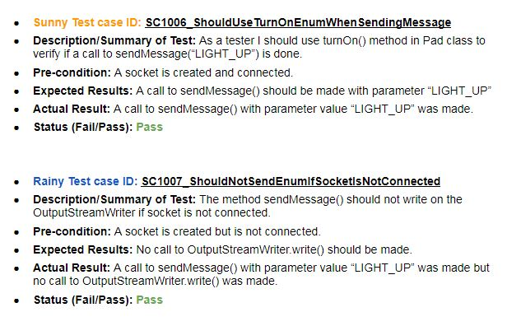
2. Refactor Pad Connection as a Service Test Cases
Notes:
10 seconds
A description of verification process and Test Suites and Test Cases for one of the use cases.
1 One sunny day and one rainy day for the implemented use cases (one or more slides).
2 Automated test scripts for the implemented use cases (if any) (one or more slides).

Slide 29
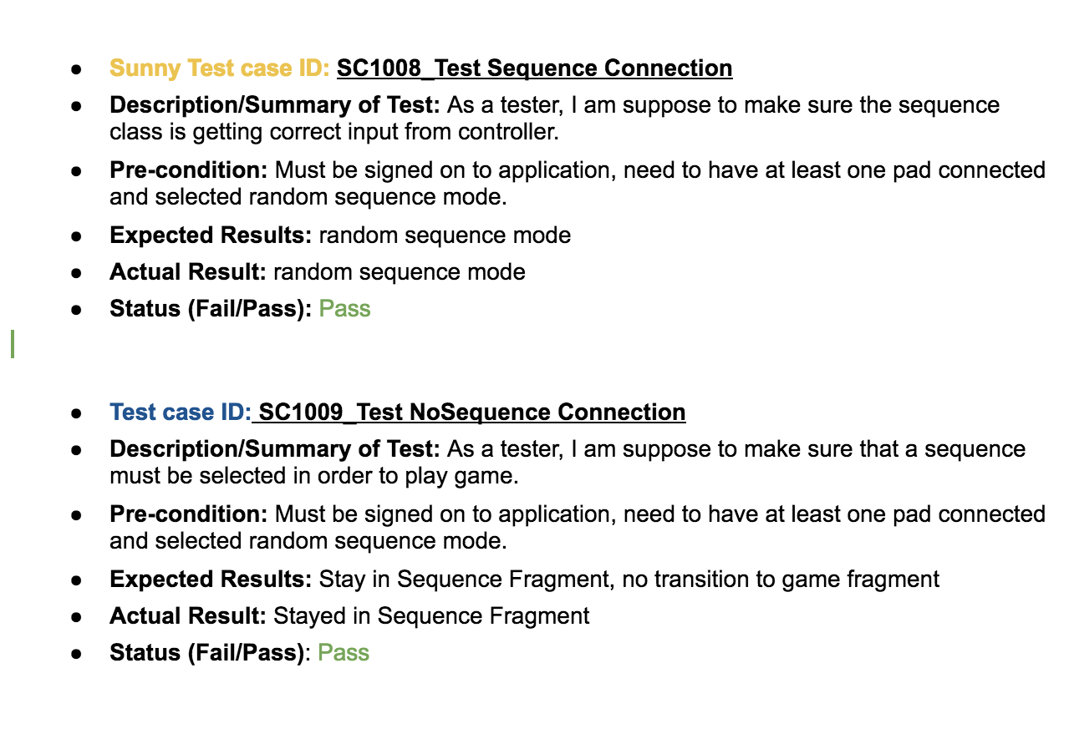
3. Design Architecture for Sequence Test Cases
Notes:
10 seconds
A description of verification process and Test Suites and Test Cases for one of the use cases.
1 One sunny day and one rainy day for the implemented use cases (one or more slides).
2 Automated test scripts for the implemented use cases (if any) (one or more slides).

Slide 30










Technologies Used
Notes:
10 seconds
Summarize your contribution, mention your effort for Scrum, Mingle, Github, Google Drive Documentation and minutes
Include your contact information
Ask if anyone has any questions for you.
Thank your audience

Slide 31
Contact Info
Product Owner: Guðmundur Traustason
Email: gummi.traustason@gmail.com
Mentor: Joshua McLendon
Developers Spring 2018:
Carlos Alva
Sandra Hurtado
Sergio Rosales

